Slide 1

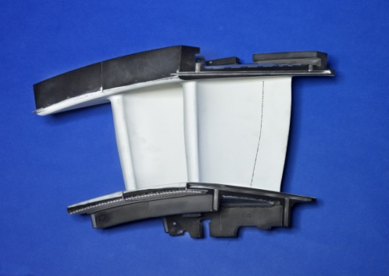
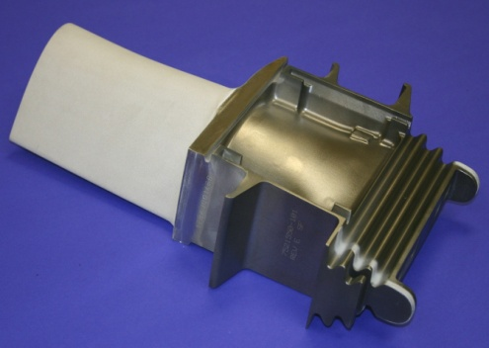
Supplier ITPs Submittal Requirements
Initial release: Nov. 9, 2018 Rev A
Updated: July 17, 2019 Rev C

Slide 2
Introduction
Inspection and Test Plan (ITP) is PSM’s method for assuring Inspection, Qualification, Process verification and Compliance to final requirements.
I&TPs are created based on the Purchase Order Scope of Work, component complexity and Supplier history.
All documentation is to be submitted by the Supplier in one single package, which will be reviewed by PSM Quality, for completeness, accuracy, and conformance to requirements prior to shipment. FAI packages are to be submitted separately. Files should be named to identify their content.
ITP’s are controlled by PSM and not Supplier specific.
ITP’s Process Requirements section is to be filled out completely.
ITP’s are to be delivered for each order.

Slide 3
Introduction
Always call the PSM Quality department if you have any questions, or concerns.
Always put the I&TP coversheet and Serial Number List in the Crate with hardware for tracking purposes.
The following pages provide instructions that must be adhered to, for successful submittals to PSM.
ITP will replace ADP in the near future.
Below are ITP’s guidelines.
The incentive in most cases is to complete each phase in a controlled disciplined approach. The objective is to complete each phase, and to eliminate redundant documentation. Once the production phase is reached only a Certification on Conformance (CoC) will be required.

Slide 4
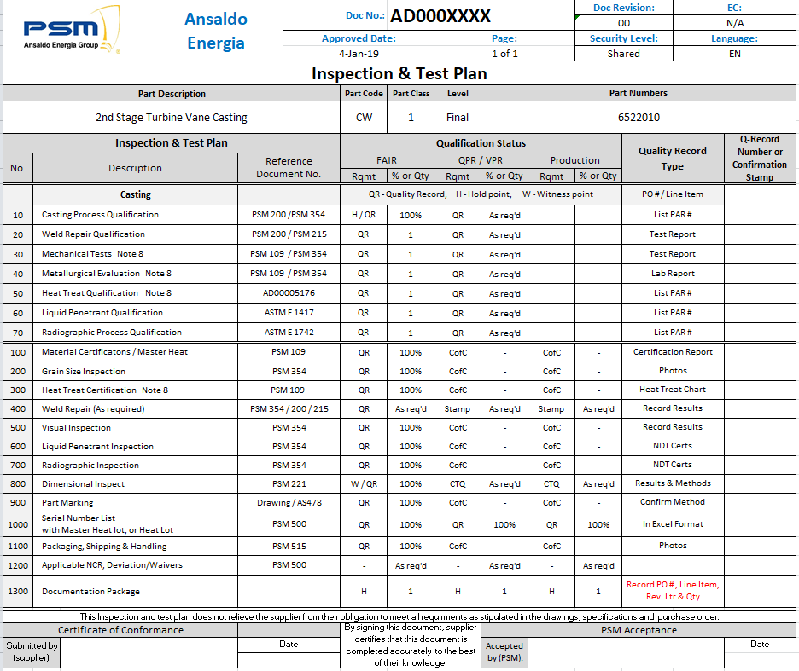
Overview of an Inspection & Test Plan

Slide 5
ITP Information
Header Information
Qualification Req. information
Process Req. information

Slide 6
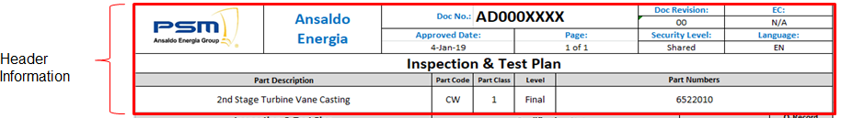
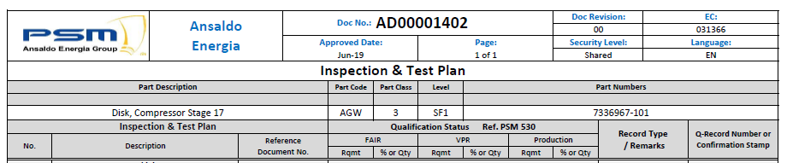
I&TPs Header Information
This section “Header Information” contains detail information that applies to this I&TP and to the part related.
It is only informative and no action is required. The exception being Generic I&TP issued for Class 4 hardware ( Ref. PSM 530). See Pages 17 & 18.
Header information such as; PSM Document No:, Document Revision, Engineering Change, Approved date.
Part Description, Part Code, Part Class and Part numbers that this I&TP applies to will be completed with specific information. See Example below:
Note: Serialization is comprise of the 4 digit Vendor Code and part code. The Part Code is listed in the Header (Vendor code is not).
Contact PSM Quality if you do not know your 4 digit Vendor Code. See PSM 500 for serial number requirements

Slide 7
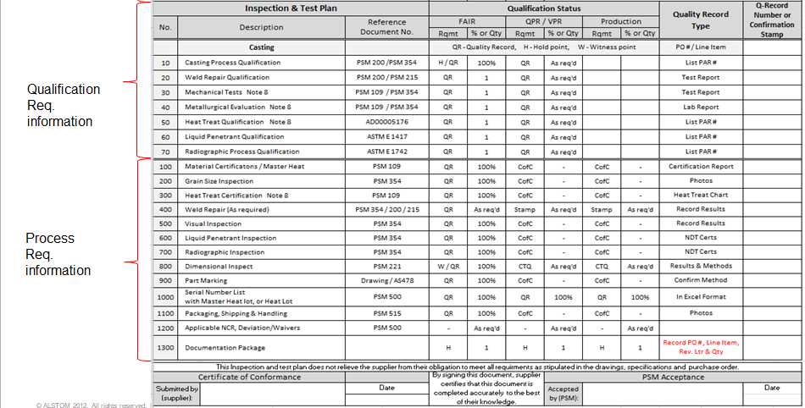
ITP Sectional Information (Qualification/Process)
Qualification and Process Requirements are separated and noted by a double line that divides both sections of the requirements
Qualification Requirements are only conducted once and they normally have a direct link to a design specification in order to meet design/performance and product life. It is a way to assure components and process specs are established and in control.
Process Requirements need to be documented for each order showing process document/control information to be supplied with each purchase order.

Slide 8
ITP Sectional Information
Qualification and Process requirements are separated by a double line that divides both sections of the requirements.
Qualification and Process Requirements are described in three sections horizontal: 1. Inspection & Test Plan, 2. Qualification Status and 3. Quality Records.
To each section (1, 2, 3) vertical Requirements are identified for Qualification/Process descriptions, status and records necessary to become qualified and approved.
1
2
3

Slide 9
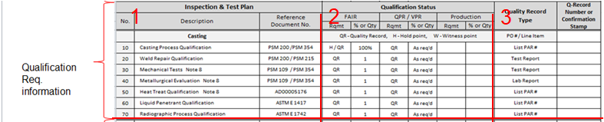
I&TPs Qualification Information
Qualification Requirements are divided into three main section:
  1. Inspection & Test Plan
    No.:
    Description:
    Reference Document:
  2. Qualification Status
    FAIR
    QPR/VPR
    Production
3. Quality Record
    Quality Record Type
    Q-Record Number of Confirmation Stamp

Slide 10
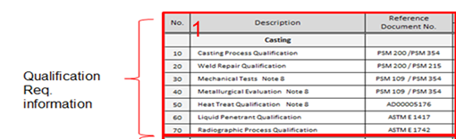
Qualification Information
  1. Inspection & Test Plan
  No.: The sequence of operations or qualification requirements needed for approval.
  Description: of the qualification needed.
  Reference Document: Specification to meet in order to become qualified.
  Note: When a PSM Specification is listed in the I&T plan and it is not on the drawing, the flow down requirement originates with the governing specification PSM 500 & PSM 210.

Slide 11
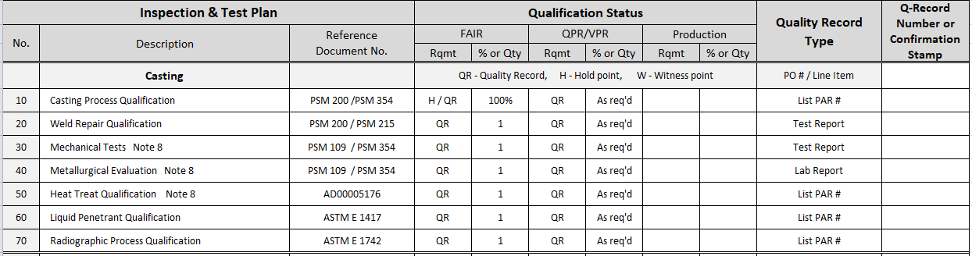
Qualification Information
  2. Qualification Status
  This area is managed by the supplier and PSM in order to understand what is required in the Qualification process.
FAIR: Section shows Requirement and % or Qty to be produced for a FAIR.
Conditional Qualification: used after FAIR parts has been in controlled and approved.
(Conditional Qualification is used to dial in the process after the first lot, but prior to Production).
Production- Requirements have been approved and ready for full production.
    * QR: Quality Record Information to be recorded
    * H: Hold Point are used to Hold product until further noticed example waiting for test results.
    * W: Witness Point are used in order to witness a process by PSM or Representative.
(Qualification Status starts by developing the FAIR parts needed to understand if the supplier has the capability. Then, it moves to Conditional Qualification where parts are produced in order to dial in the process. Once Conditional approval has been granted full production and the process is locked in)

Slide 12
Qualification Information
  3. Quality Record
  Quality record Type; type of document or record used for approval to document qualification or process approval.
  Q-Record Number or confirmation: approval number of quality record type or stamp of approval (meaning the Qualification or Process number has been approved and meets the requirement.
  Note: Once qualified, providing the objective evidence of compliance is critical. Most documentation in this category have control numbers. Please provide the control number in the area provided. Test and Lab reports must be provided with the package upon submittal to PSM.

Slide 13
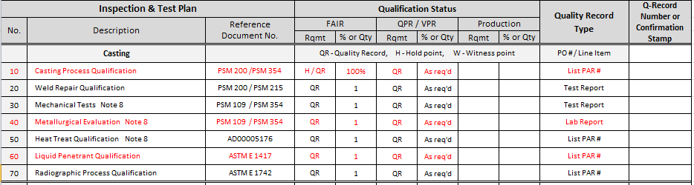
Qualification Req. EXAMPLES
  Examples on 3 different qualification Highlighted in red.
  No: 10
  Description: Casting Process Qualification.
  Reference Document: PSM 200 / PSM 354 (Supplier must follow this specification in order to be qualified for this process. Qualification data must be submitted to PSM Process Engineering for review and approval. A PAR document ( Form 000123) and associated control number will be provided to the supplier. It is this PAR Number that must be recorded.
  FAIR
    Rqtm “H / QR” % or Qty “100%”
    Meaning: In the FAIR phase there is Hold meaning PSM will need to verify the pilot parts and a Quality Record that must be used for recording 100% of inspection.
  QPR/VPR:
    Rqtm “QR”
    % or Qty “As req’d”
    Meaning: in the VPR Phase, a Quality Record must be used in order to record the inspection results and As req’d the quantity to be inspected. This information is communicated to the Supplier via the FM000254 Approval form.
    Quality Record type states the type of document needed and Q-Record indicates to add approval number or stamp number of approver in that column. ( Example Employee Number)

Slide 14
Process Information
  Inspection and Test Plans,Qualification and Process Requirements are read and filled out as explained above.
  Note: Providing the objective evidence of compliance is critical. Most documentation in this category have control numbers. Please provide the control number in the area provided. Process Certs, Test and Lab reports and other documents number must be recorded and provided with the package upon submittal to PSM. Verification requires a signature , or clock number.

Slide 15
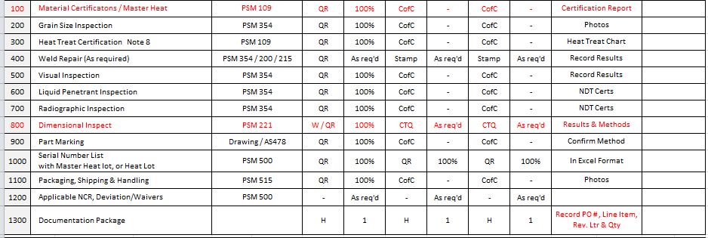
Process Req. EXAMPLES
  Examples Process Verification/Certification Highlighted in red.
  No: 100, Material Certification must meet PSM 109. PILOT/FAIR will require Quality records and 100% inspection recorded. Conditional Qual will require quality records and 100% inspection. Production phase will require Quality records and 100% inspection. Quality Records a Certification Report will be needed.
  The reason this is 100% Inspection required is because it is the Raw material or Material certs.
  No. 800, Dimensional Inspect must meet PSM221. FAIR requires a Witness of inspection and pilot parts inspected 100% in order to meet FAIR with a Quality Record. Conditional Qual will require Quality Records and a sample of parts to be inspected. Production will also require quality records of inspection and also a sample size. Quality Record Type will be dimensional results and methods of inspection. Q-records will be stamp or signature of who inspected the parts.

Slide 16
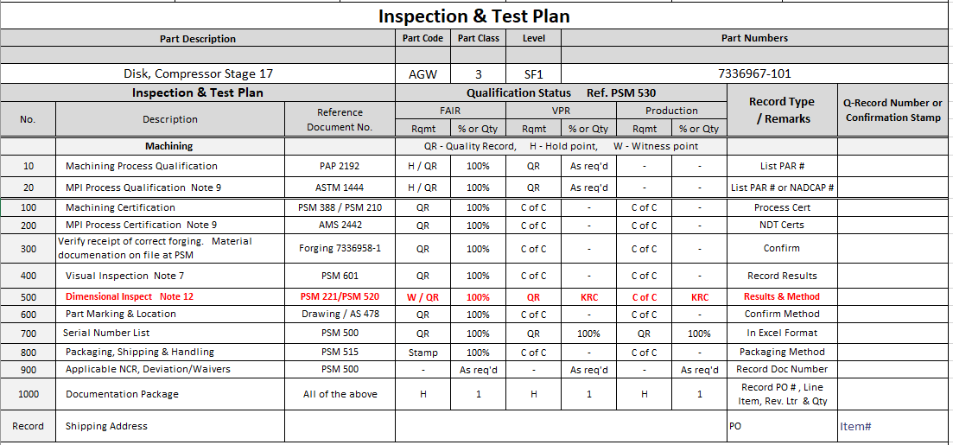
Process Req. PSM 520 & KRCs
Along with complying with the Dimensional Inspection and First Article requirement, Critical Characteristics and /or Key Recordable characteristics (KRC) are require as part of this sequence. PSM 520 provides guidance on how to document and submit to PSM Engineering. KRC’s are process control dimension and are either defined on the drawing or communicated to the Supplier via a supplemental drawing that defines which dimension to inspect, record and submit to PSM. If no KRCs are identified in the Drawing or Specification the entry to the I&T plan would be “N/A” in the VPR or Production phase..

Slide 17
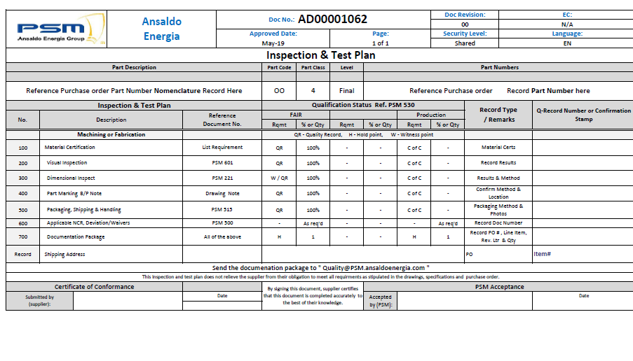
Generic Inspection and Test Plans Class 4 Parts
Generic Inspection and Test plans are assigned to simple or non-complex hardware. The supplier must fill out the in the Header field with the Part Number and Part Nomenclature. ITP # AD00001062 is for use on hardware with No Special processing. This ITP is assigned and will be provided by the PSM Buyer or PSM Quality department.

Slide 18
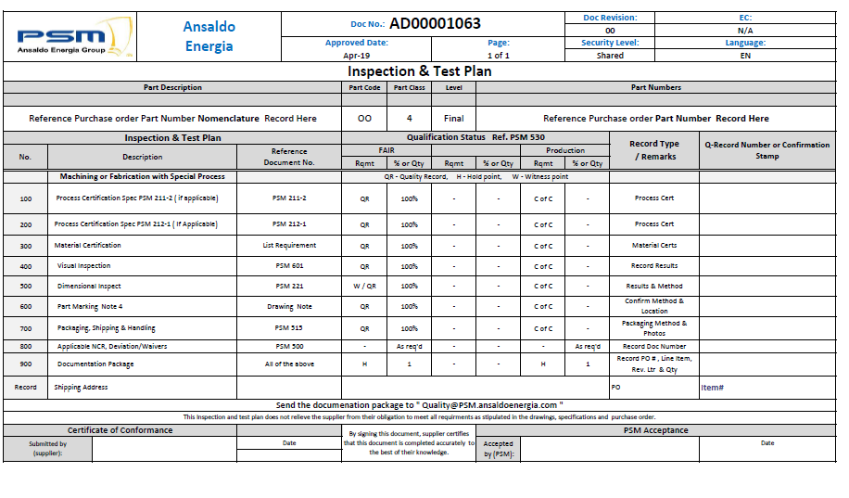
1)
Generic Inspection and Test Plans with Special Processes
Generic Inspection and Test plan # AD00001063 is for use on hardware with some Special processing that does not require qualification, only certification. This ITP is assigned and will be provided by the PSM Buyer or PSM Quality department. The supplier must fill out the in the Header field with the Part Number and Part Nomenclature.

Slide 19
Certificate of Conformance
Certificate of Conformance ( CoC): Supplier may provide their own Company specific CoC along with the signing of the ITP CoC. The supplier may choose to only utilize the ITP CoC. PSM will recognize either scenario.

Slide 20
ITP Do’s & Don’ts
Do:
Submit ITP’s in a timely manner 3+days prior to shipment is preferred.
Contact PSM Quality at any time with questions.
An ITP’s is required for all PSM Hardware. COTS parts are the only exception.
Complete ITP’s header with purchase order line item number & quantity being submitted / set number if applicable.
Complete shipping address to next PO destination. Located at the bottom of new I&T Plans
Review documentation for accuracy and typographical errors.
For inspection reports and first article inspections, verify any noted nonconformance has an associated NCR submitted to PSM.
Always submit serial numbers in the required Excel format along with the corresponding part number.
Follow PSM serial number format ( vendor code-part code-number)
When submitting ITP’s on the same day for the same part number add a revision level (-A, -B, -C) as needed to the ITP’s number to maintain separation.
Always submit ITP’s packages to “quality@PSM.ansaldoenergia.com“
Don’t:
Leave the ITP’s blank.
Alter the ITP’s format.
Submit incomplete ITP packages.
Submit multiple ITP’s in one email.
Combine line items on the ITP’s (i.e. LINE 10/20).
Combine multiple PO’s (PO numbers) per ITP’s.
Combine/leave multiple part numbers on one line item.
Insert dashes, spaces, or back slash into PSM serial number format. See PSM500 section 9.1.3.

